Slide 1
Facial Recognition in Challenging Environments

Slide 2
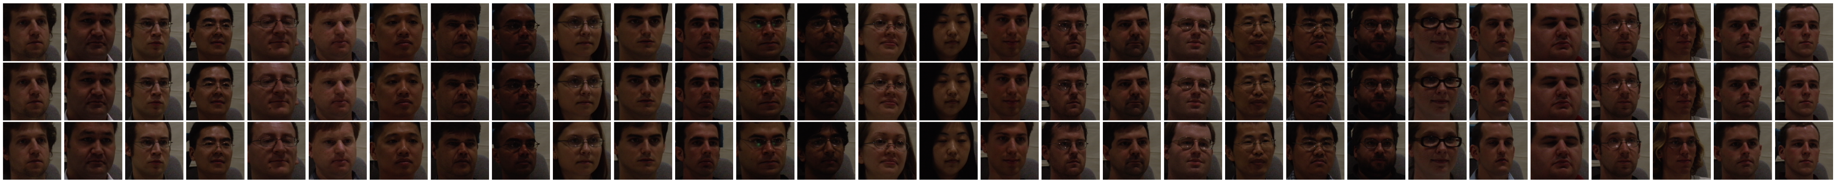
CNN MODEL
Dataset:
Training:
Dataset | No .of samples | Face angles | Accuracy
Multi-PIE | 3606 | 0° | 1.00%

Slide 3
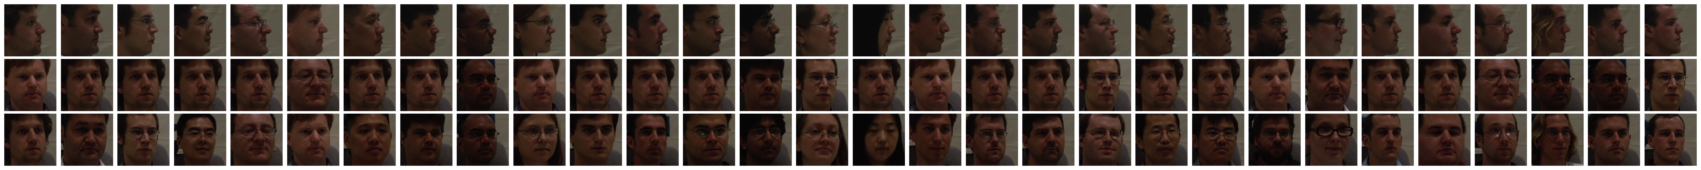
Testing
Dataset | No .of samples | Face angles | Accuracy
Multi-PIE | 12034 | 15° to 90° -15° to -90° | 0.38%

Slide 4
Style GAN
For face frontalization
Dataset statistics
It can able to frontalize all angle images
It can able to generate all 30 faces
Dataset | No .of samples | Face angles
Multi-PIE | 15630 | 15° to 90° -15° to -90°

Slide 5
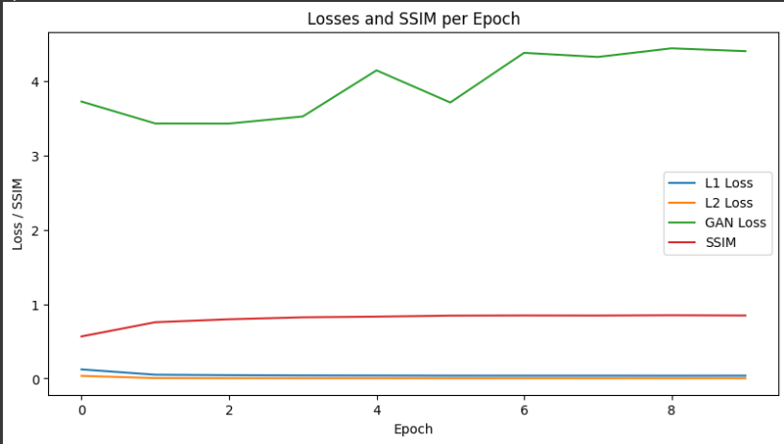
Style GAN Loss functions
BCE loss function

Slide 6
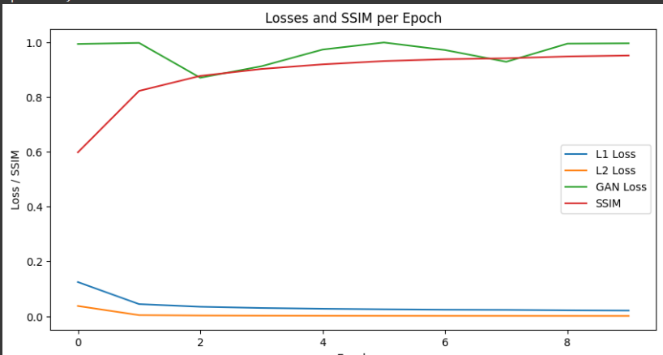
MSE loss

Slide 7
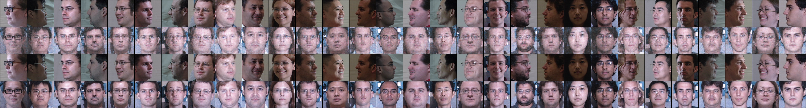
GAN models Compare plot

Slide 8
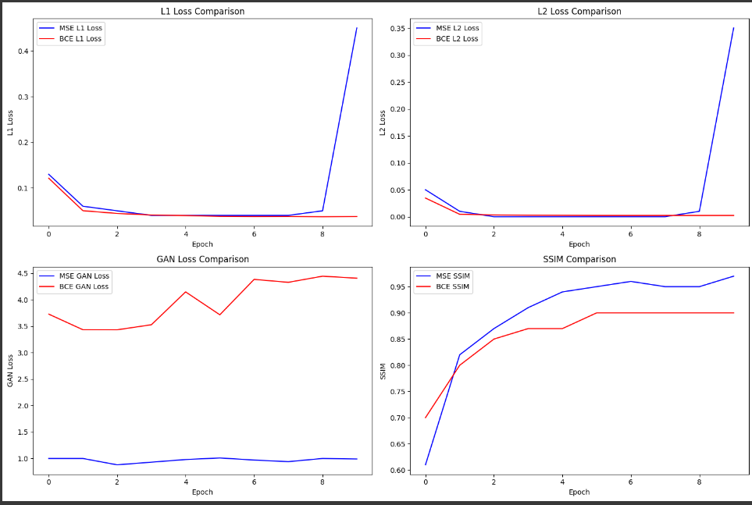
Individual comparison plot

Slide 9
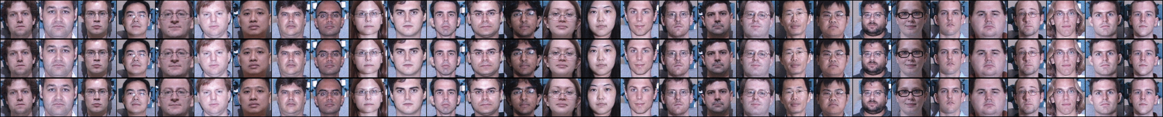
Generated sample testing

Slide 10
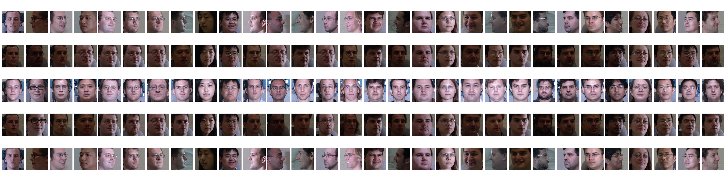
Final outcome

